Slide 1

Assignment #1
Fangji Chen

Slide 2
Processing Image
Useful Libs of processing Videos and Images
Dev Kit | CPU | GPU
PyCuda | import cv2 example: cv2.grabCut() | coding c++ in pycuda.compiler.SourceModule to define GPU thread behaviors
OpenCV CUDA | import cv2 example: cv2. createCLAHE() | 1. using src=cv2.cuda_GpuMat().upload(img) to upload image ndarray to GPU. 2. using dst=cv2.cuda.some_func().apply(src) to process it. 3. After all, download result with dst.download().
Processing Video
Dev Kit | CPU | GPU
PyCuda | import cv2 example: applying cv2.cvtColor() to do a Canny transformation | same as processing images: coding c++ in pycuda.compiler.SourceModule to define GPU thread behaviors
OpenCV CUDA | import cv2 | 1. using src=cv2.cuda_GpuMat().upload(frame) to send frame data from CPU to GPU. 2. using gpu_bgr=cv2.cuda.some_func().apply(src) to process it. 3. After all, download result with gpu_bgr.download().

Slide 3


Comparison of CPU and GPU
advantages
CPU is designed to handle a wide range of tasks quickly
GPU is designed to quickly render high-resolution images and video concurrently
disadvantages
CPU is much slower when processing images and videos
CPU is not designed for parallel computing
GPU cores are less powerful in terms of clock speed
GPU cores also have less diverse instruction sets

Slide 4
Practicing with Python Numba
CUDA Python Numba:
Numba is a key development to support NumPy arrays.
Most capabilities of NumPy arrays are supported by Numba in object mode
A few features are supported in nopython mode too
Decorating a Python function with the jit or autojit decorators:
# define a kernel
@cuda.jit
def function(*argc, **argv) {}
A few noteworthy limitations of arrays at this time:
Arrays can be passed in to a function in nopython mode, but not returned. Arrays can only be returned in object mode.
New arrays can only be created in object mode.
Currently there are no bounds checking for array indexing and slicing, although negative indices will wrap around correctly.
A small number of NumPy array ufuncs are only supported in object mode, but the vast majority work in nopython mode.
Array slicing only works in object mode.
In this section, we will create two arrays usign CUDA, we will sum them up and check the time.

Slide 5
Practicing with Pycuda
The full global thread ID in x dimension can be computed by:
tid = blockIdx.x * blockDim.x + threadIdx.x;
Using tid to define behavior of each GPU thread
Libraries
import pycuda.driver as cuda
import pycuda.autoinit
The pycuda.driver module has methods that:
Allocate memory on the GPU (cuda.mem alloc())
Copy numpy arrays to the GPU (cuda.memcpy htod())
Execute kernels on the GPU described by CUDA code (see compiler.SourceModule)
Copy data from the GPU back to numpy arrays (cuda.memcpy dtoh())
The pycuda.SourceModule(). Using SourceModule to compile code to manager GPU computing resources:
mod = SourceModule(""” cpp codes """)

Slide 6
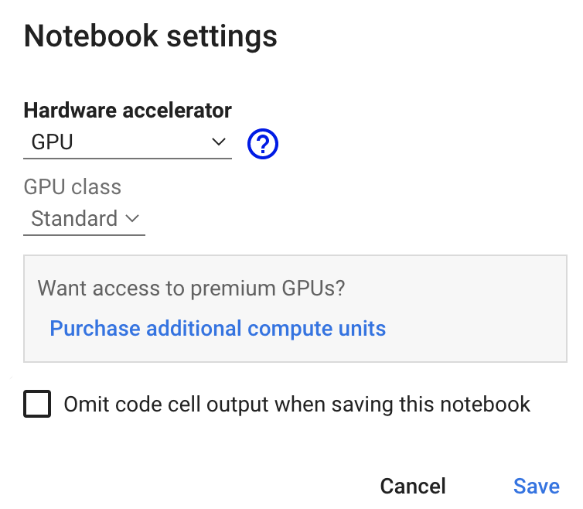
Discussion & Conclusion
Difficulties, issues, challenges and concerns
I can’t prepare a local CUDA environment because MacOS does not support NVIDIA Graphic Card after 10.10
Then I prepared CUDA environment at google Colab
There are other coding errors in the notebook example codes.
I fixed some of them, but there are still some code blocks I can’t run. I’m still working on that, trying to fix that.
Conclusion
processing video and image with GPU is much faster than with CPU because of the ability of parallel processing.
We need to import different modules and packages to use different CPU/GPU runtime environments.

